Slide 1
Group 1
Bouhadan Imad, Dellafaille Lander, Mariën Levi, Pepermans Manu, Van de Mieroop Kevin

Slide 2

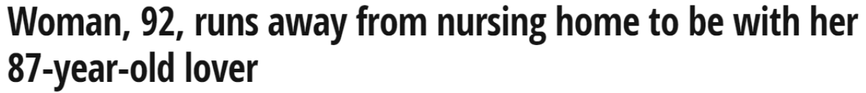

Introduction
Eldertrack
What is ElderTrack?
What can ElderTrack do for you?
Is ElderTrack worth buying?

Slide 3
Introduction
Eldertrack
Indoor localization (floor and room)
Outdoor localization (coördinates)
Cloud based monitoring platform

Slide 4
Buildup of the project
Outdoor
LoRaWAN
data
Back-end
DASH7
RSSI + DATA
Indoor
GPS
Parsing
Barometer
ThingsBoard.io
Temperatuur
Fingerprinting
e-Compass
Altitude

Slide 5
Backend
Parsing
Subscribed to 3 MQTT topics:
/tb: Dash7 data
/loriot: LoRa data
/localisation: RSSI values for kNN
Publishing to ThingsBoard.io with ThingsBoard API and MQTT
Remote procedure call with ThingsBoard API

Slide 6
Backend
Parsing
Dash7 data is parsed through checking the first value:
“M”agnetometer information:
0-360 degrees -> changed to cardinal direction
“B”arometer information:
raw values from sensor -> changed to altitude
“O”K message
Dash7 RPC is received by node
“E”rror message
LoRaWAN is not joined on node
LoRa data is parsed through checking if GPS information is valid:
“A”ctive, GPS data is valid
change minutes to degrees and correct if GPS data is from Southern Hemisphere
kNN is calculated if RSSI values are received within one second form at least 3 gateways

Slide 7
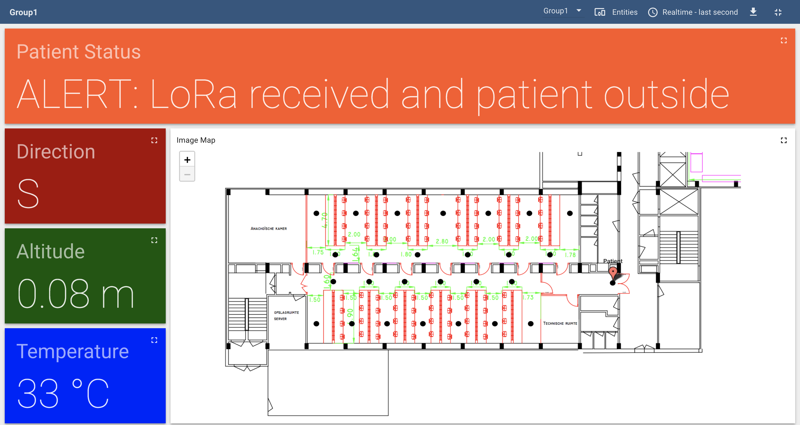
Backend
Thingsboard.IO

Slide 8
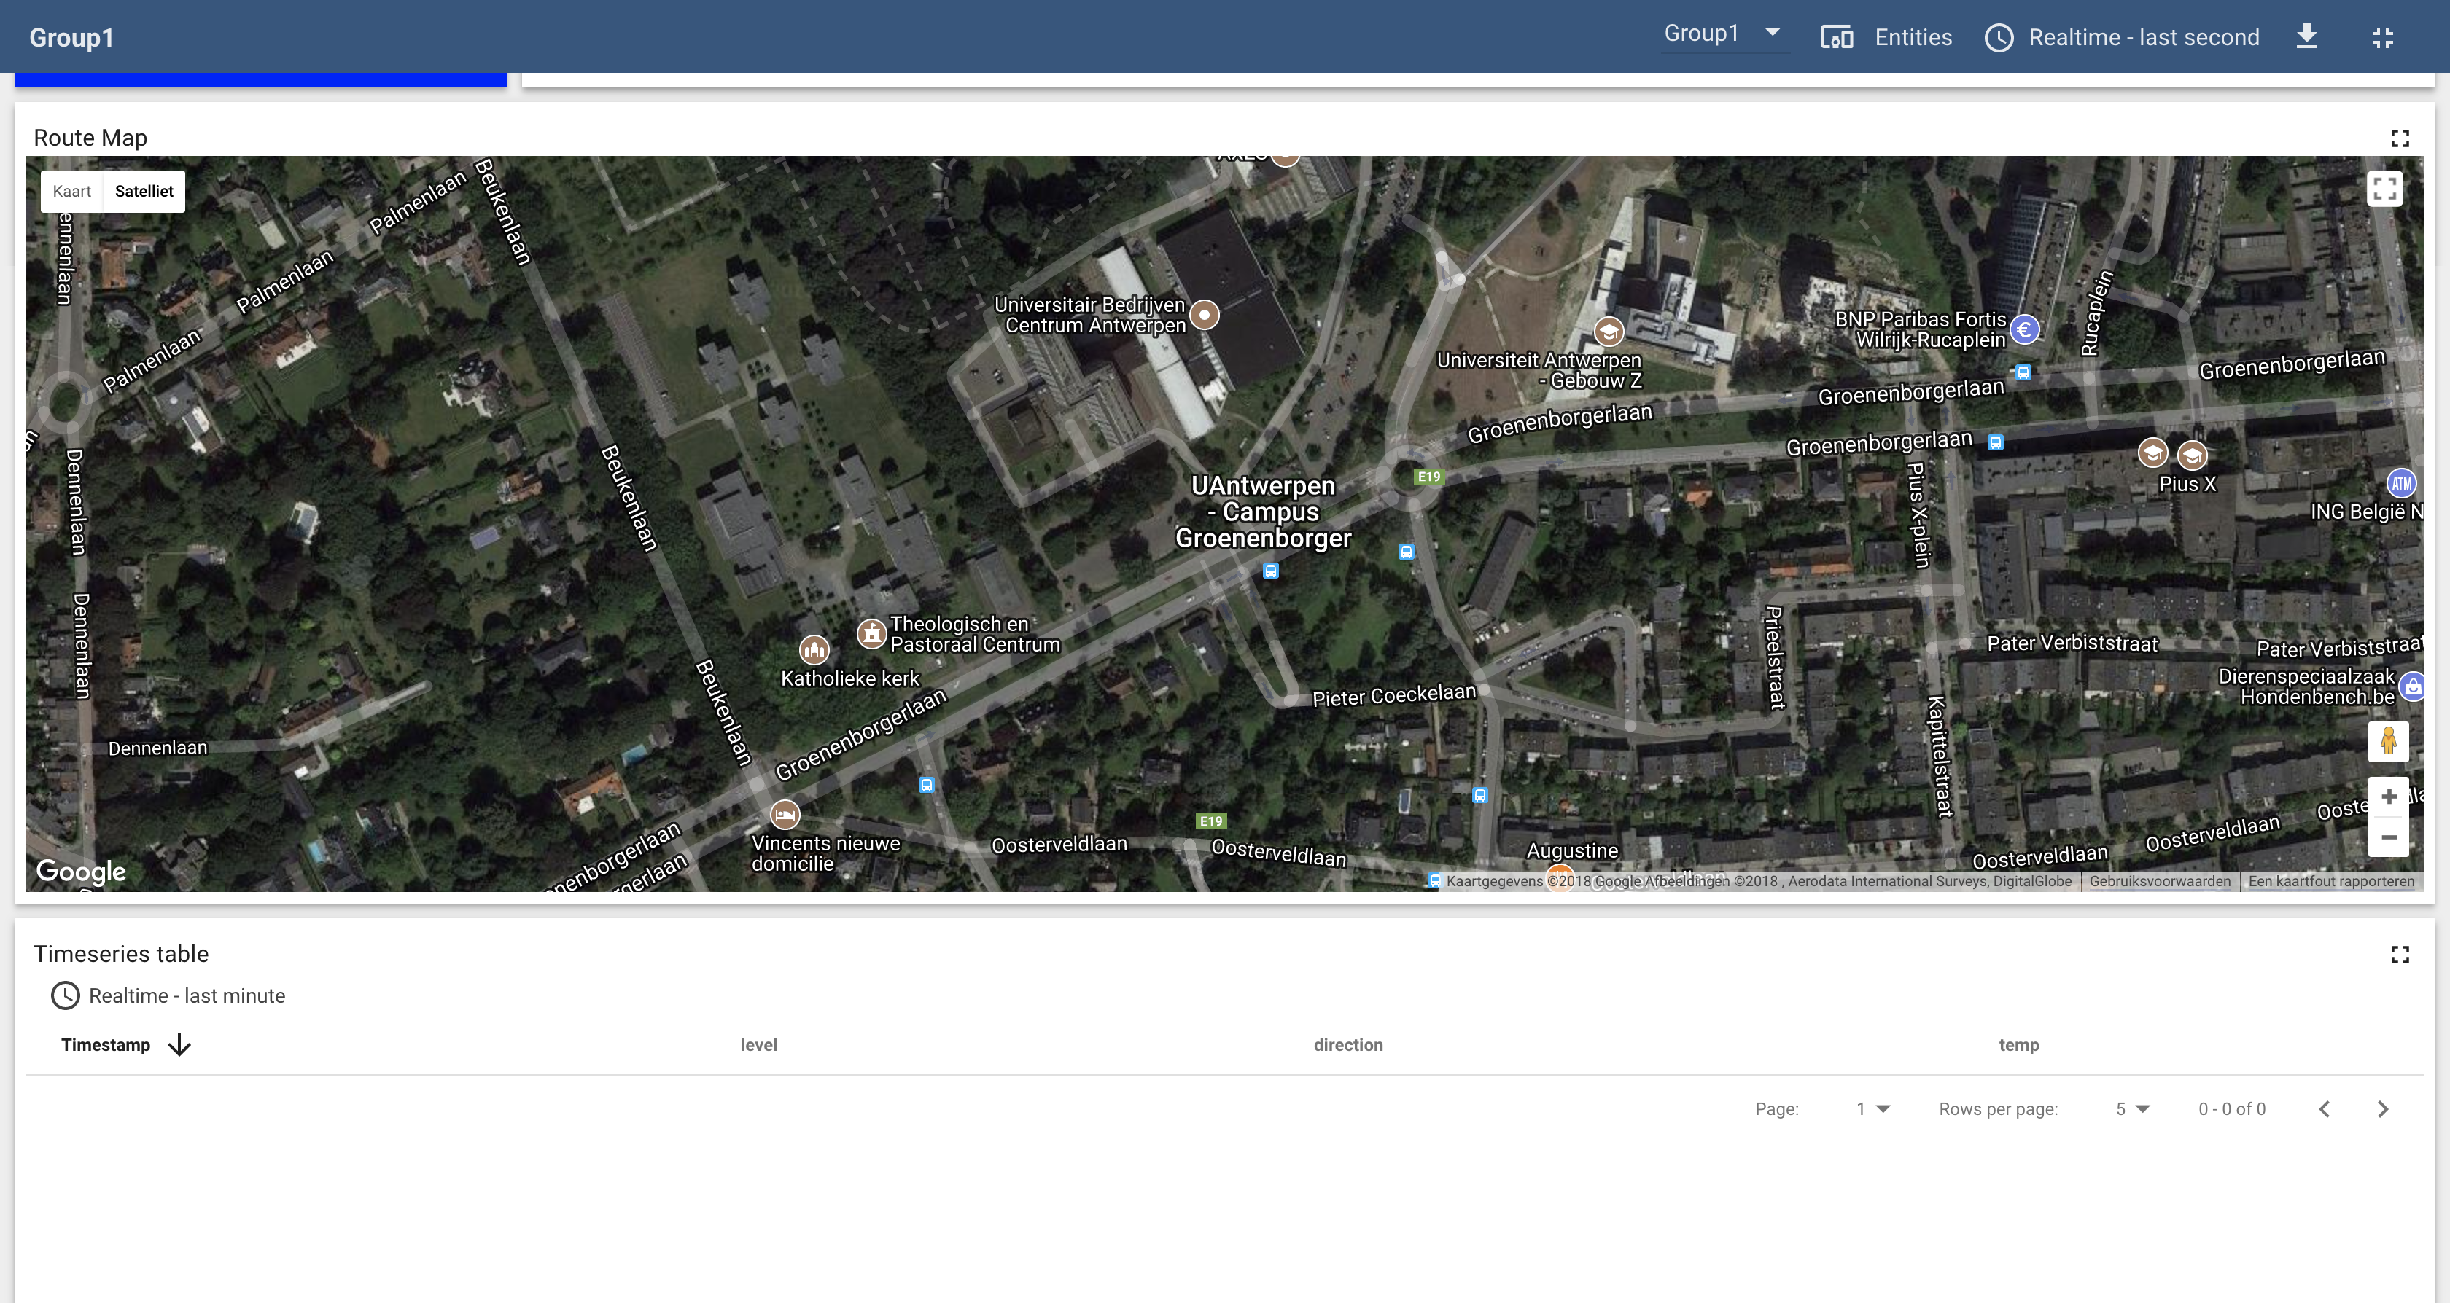
Backend
Thingsboard.IO

Slide 9
Fingerprinting
training
Define training locations 27
26 inside + 1 outside to detect danger zone
Collect measurements 20 per location
More measurements, higher accuracy
Set up database for comparison

Slide 10
Fingerprinting
operational phase
Receive Data
Calculate Distances
Find Neighbor
Vote on labels
2.2
2
2.4
1
3.1
1
3.5
Natasha Latysheva (2016). Implementing Your Own kNN using Python. https://www.kdnuggets.com/2016/01/implementing-your-own-knn-using-python.html

Slide 11
Fingerprinting
operational phase

Slide 12
Frontend
Back-end
Frontend
Parsing
Temperature
DASH7 (Data + RSSI)
Barometer
ThingsBoard.io
e-Compass
Control
Fingerprinting
LoRaWAN (DATA)
GPS

Slide 13
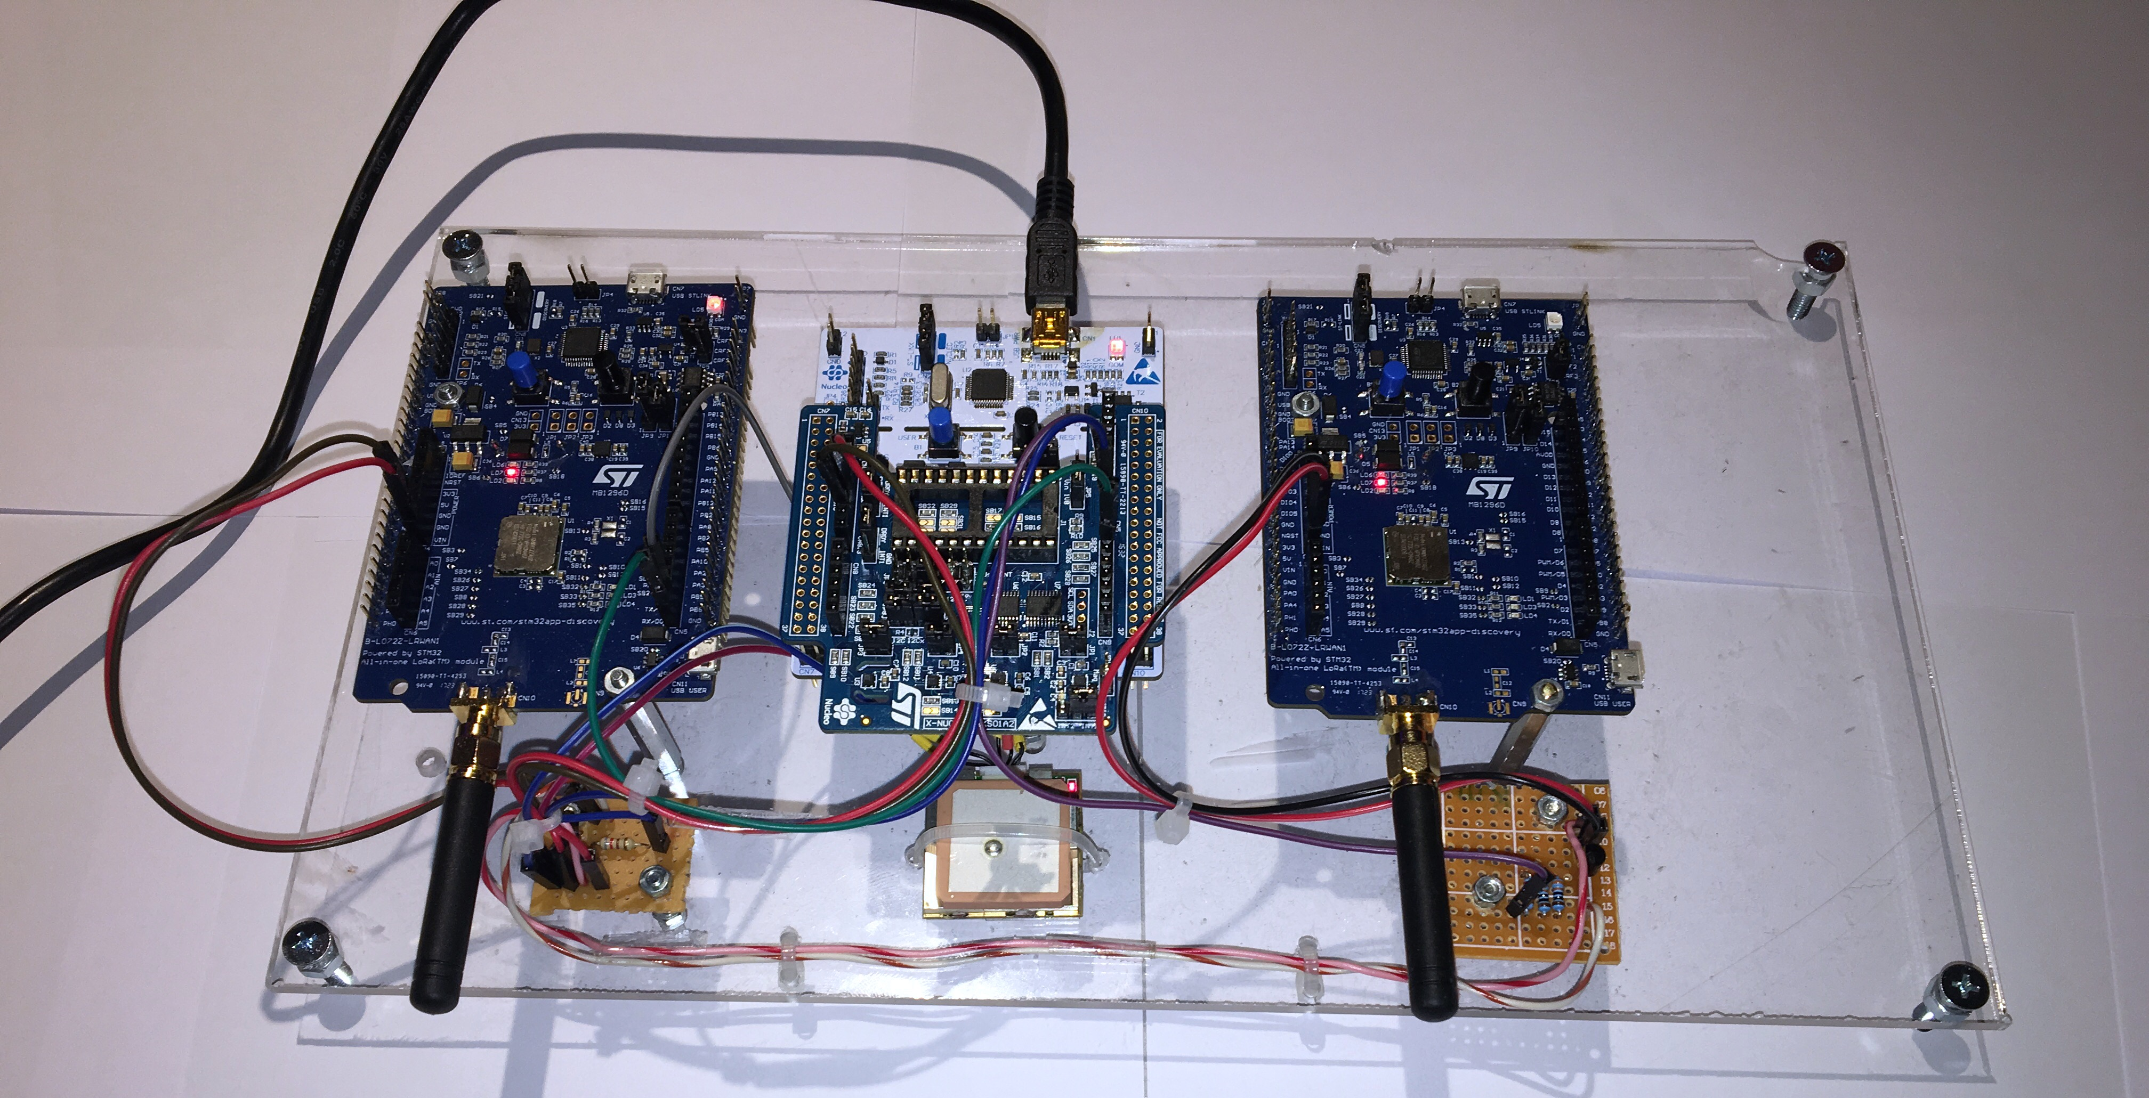
HARDWARE

Slide 14
Communication (OUTDOORs)
LoRAWAN
B-L072Z-LRWAN1
Only activated when entering danger zone
GPS Data to gateway
AT Commands
ATZ
AT+JOIN
AT+JNS=?
AT+SEND when data comes in
Notes:
Check if connection between lora-module and nucleo board
NJS = network join status, zien of lora nw joined
ATZ = microcontroller reset

Slide 15
GPS (OUTDOORS)
NMEA commands
GPGLL : Latitude, N/S, Longtitude, E/W, Time, Data valid
Initializing
AT+SEND:2=“5117.1421,N,0000428.4897,E,230746.000,A,A*56”
Optimizing: Hot start

Slide 16
Communication (INDOOR )
DASH7
Uplink: Sensordata + RSSI
Barometer and Temperature sensor
kNN
Downlink: Alarm when tracked person is outside
Listen for command
ALP Command

Slide 17
sensors
X-NUCLEO-IKS01A2
X-NUCLEO-IKS01A2
Barometer
Temperature sensor
Accelerometer
Magnetometer
Altitude & Temperature
Ecompass

Slide 18
Acquiring sensor data
Barometer 11 Temperature 11 magnetometer 11 accelerometer
Read registers
Concatenate
Convert
Scale
Usable data

Slide 19
Altitude
Indoor
Use barometer and temperature
Initial: get air pressure from weather API and use as reference
Too many different weather models
Not 100% accurate
Could be used Training
Now: measure air pressure at startup and use as reference
Calculate difference in height, taking into account temperature and change in air pressure
Define levels

Slide 20
Control Unit
Finite State Machine (FSM)
DIAGRAM

Slide 21
SENSOR Outdoor
Ecompass
Levi

Slide 22
Implementation
Drivers
Levi

Slide 23
Documentation
Levi

Slide 24
Energy consumption
Low power features
Levi

Slide 25
Energy consumption
Estimation by CubeMX
Levi

Slide 26
Energy Consumption
Measured Energy consumption
Levi

Slide 27
Possible improvements
Only send DASH7 messages when movement is detected
Outdoor localization using height and ranging
Calculate height with reference pressure at sea level
Calculate distance from home using Lora (TOF, RTT)
Height + distance Use map to determine location
Put main module in sleep mode to reduce power consumption
More measurements per point for kNN improvements

Slide 28

Demonstration

